Slide 1
Time Series Data

Slide 2
Time series components
Any time series can be divided into two parts: a systematic part and a non-systematic part.
The systematic part includes three components:
level
trend
seasonality

Slide 3
Time series components
The level is the average of all the values in the time series.
The trend reflects the overall change in the series over time – it can be increasing or decreasing. Trend can be evaluated using different types of functions like linear, polynomial, exponential, logarithmic etc.

Slide 4
Time series components
Seasonality (seasonal variation) is represented by a cyclical behavior over time. A time series with seasonality exhibits regular and predictable patterns that repeat a number of times during the whole period.
Simple example: ice cream sales.

Slide 5
Time series components
Some series do not have trend and seasonality; however, all series have a level.

Slide 6
Time series components
The non-systematic part (noise) is the random component of the time series. This component accounts for all unpredictable fluctuations in the time series values.
These fluctuations are mostly produced by unknown or uncontrollable factors.

Slide 7
Time series components
All time series present a noise in some degree. However, if a series has too much noise (if the random component is more important than the systematic component) that series could be unpredictable.

Slide 8
Time series components
The time series components can be additive or multiplicative. A model with additive components:
y_{t} = Level + Trend + Seasonality + Noise

Slide 9
Time series components
A model with multiplicative components:
y_{t} = Level x Trend x Seasonality x Noise

Slide 10
Time series components
Furthermore, seasonality in time series can be additive or multiplicative.

Slide 11
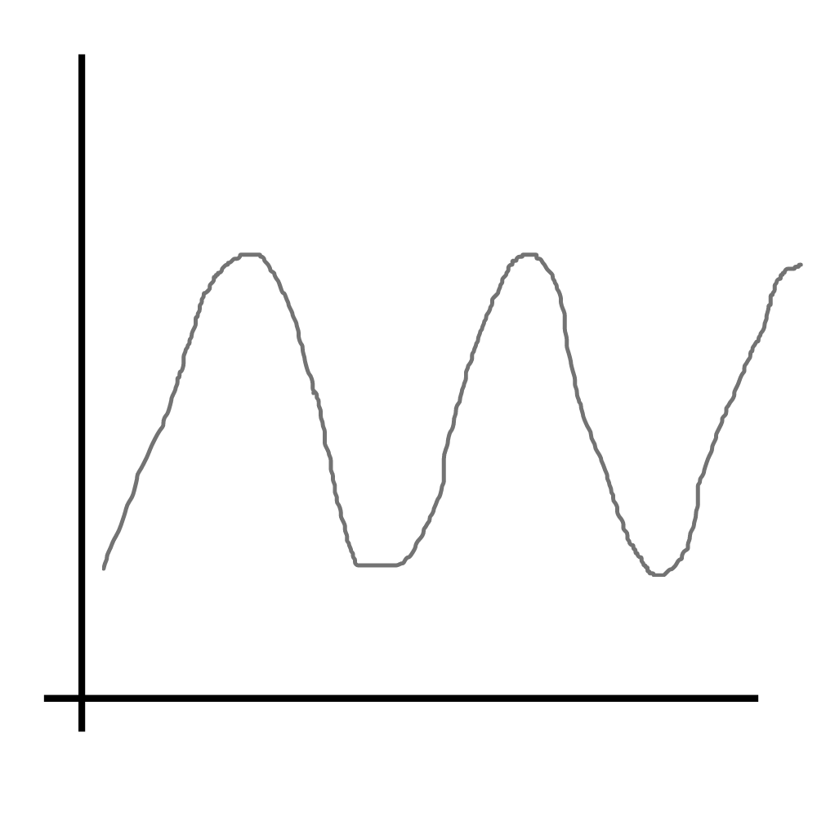
Time series components
A series with additive seasonality presents constant variations of values in different seasons:

Slide 12
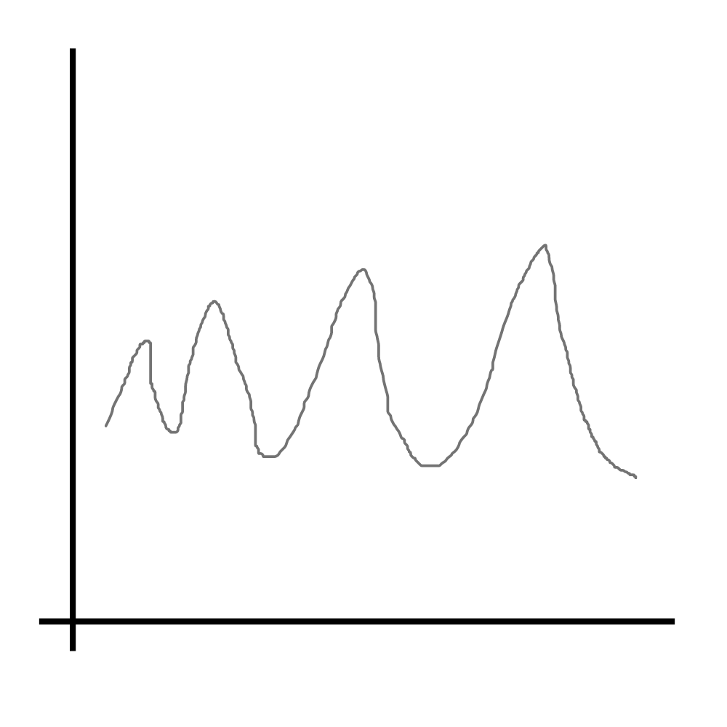
Time series components
In the series with multiplicative seasonality, variations are different from one season to another:

Slide 13
Time series components
Also, the error component (noise) can be of two types:
additive, if the errors remain constant over time
multiplicative, if the errors tend to increase when the series values increase

Slide 14
Time series components
In essence, the role of forecasting is to separate the systematic component from the noise.
the systematic component helps us make forecasts
the noise allows us to estimate the forecast errors

Slide 15
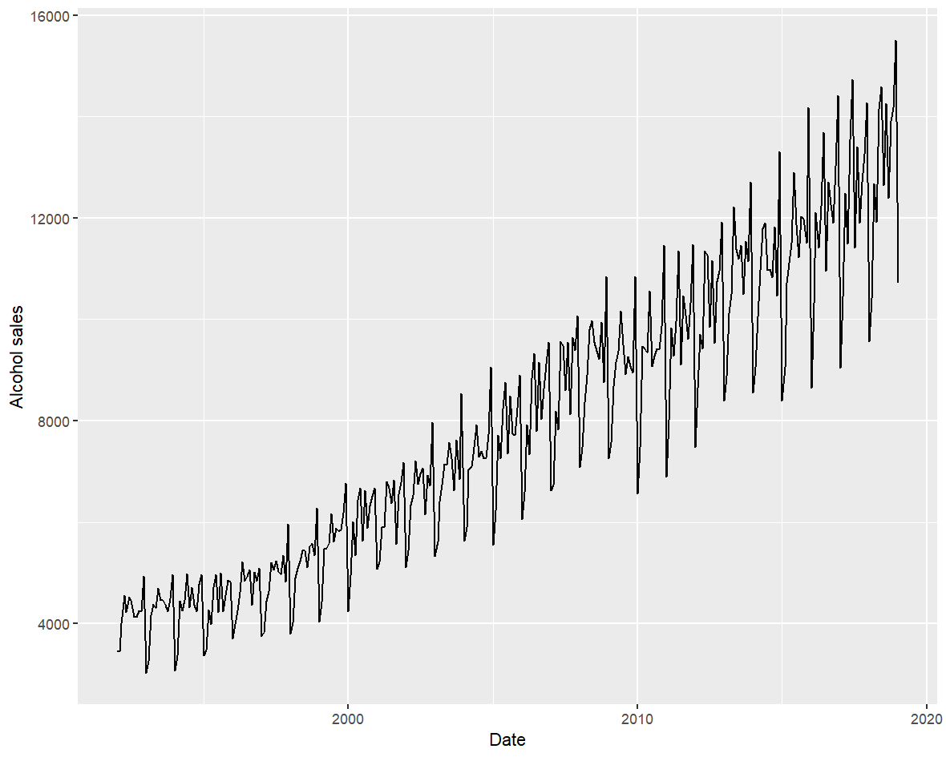
Time series components

Slide 16
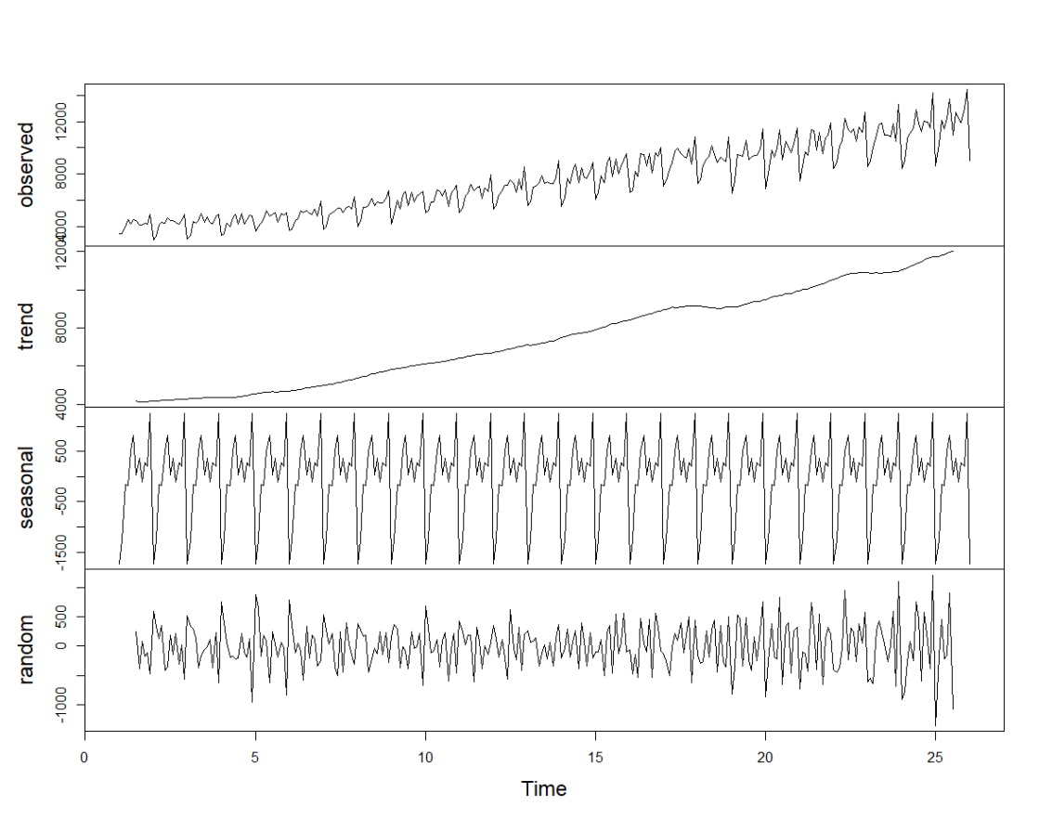
Time series components

Slide 17
Zooming into Time Series

Slide 18
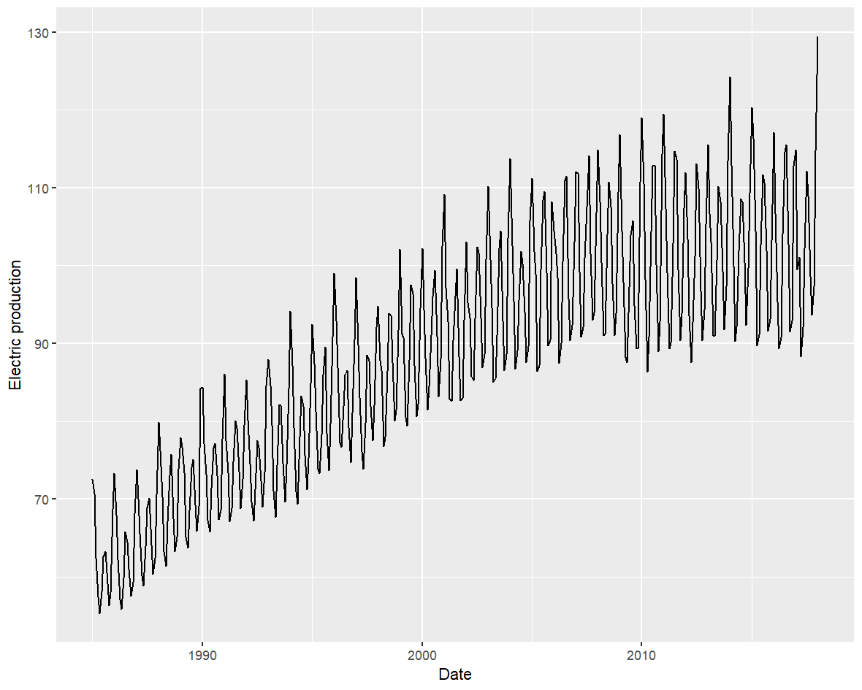
Zooming into time series

Slide 19
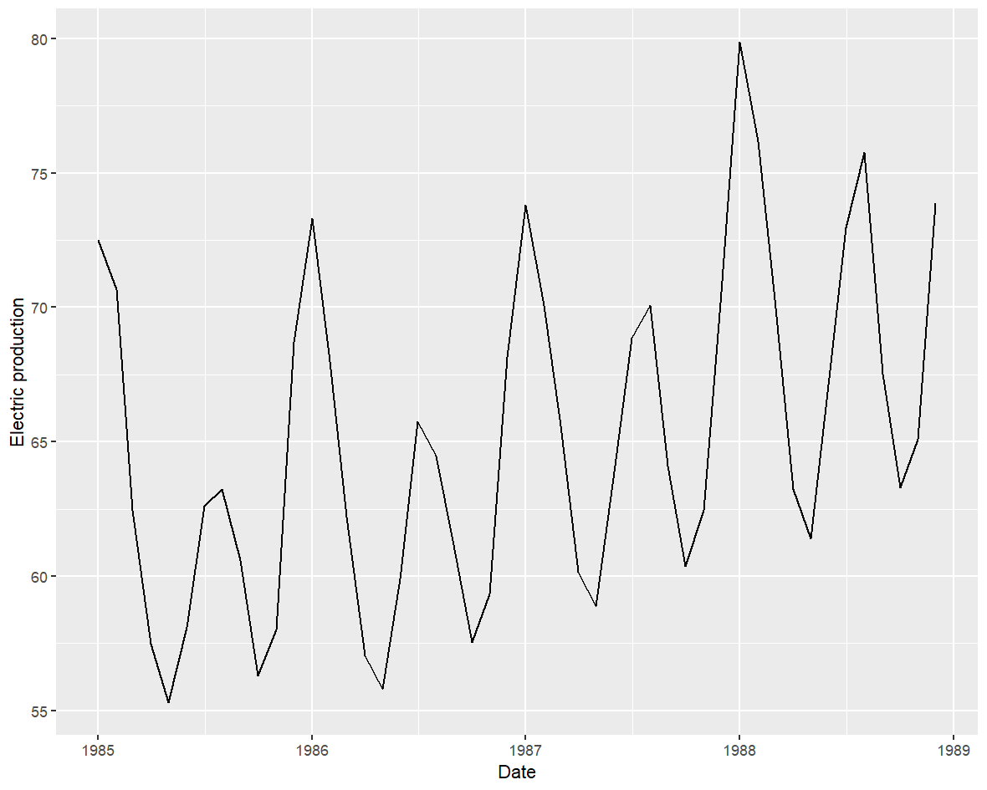
Zooming into time series

Slide 20
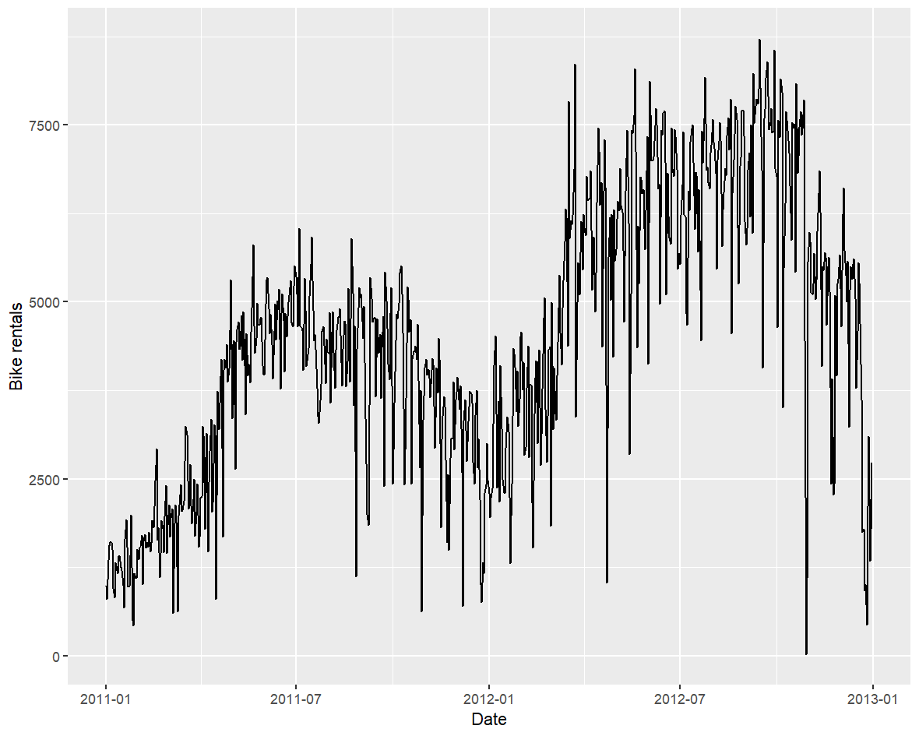
Zooming into time series

Slide 21
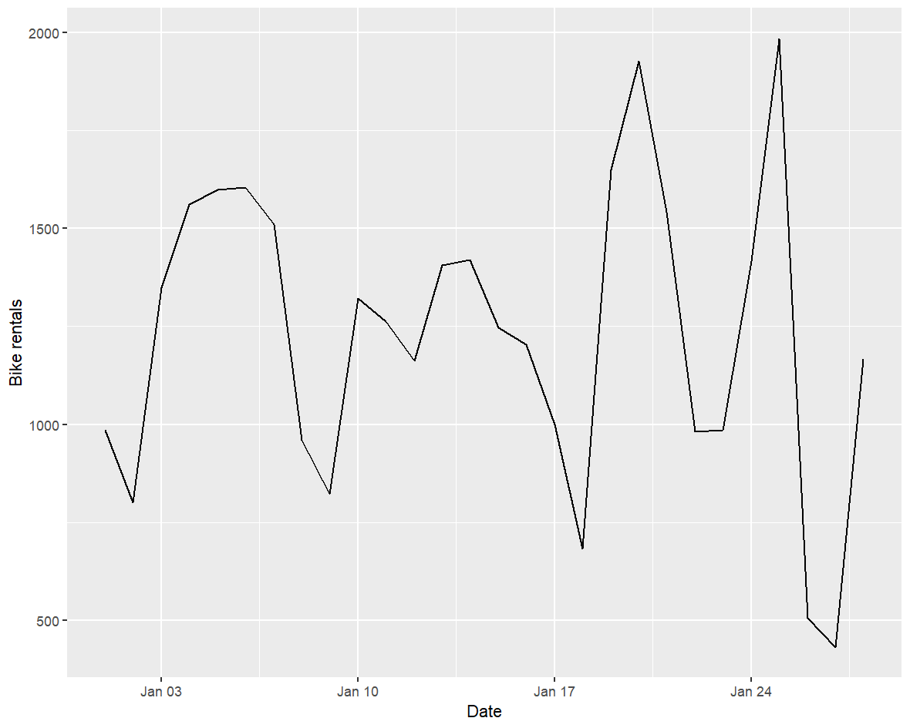
Zooming into time series

Slide 22
Adding Trend Lines

Slide 23
Adding trend lines
Adding trend lines to time series is a practical way to get the most appropriate trend shape (linear or non-linear).
A quick way to add a trend is to use the Excel program.

Slide 24
Suppressing Seasonality

Slide 25
Suppressing seasonality
There are three ways to eliminate seasonality:
aggregate data (for example, if we convert the series data from monthly to yearly, seasonality will probably disappear)
plot and analyze data for each season separately (for example, cold season and warm season)
use the moving average

Slide 26
Suppressing seasonality

Slide 27
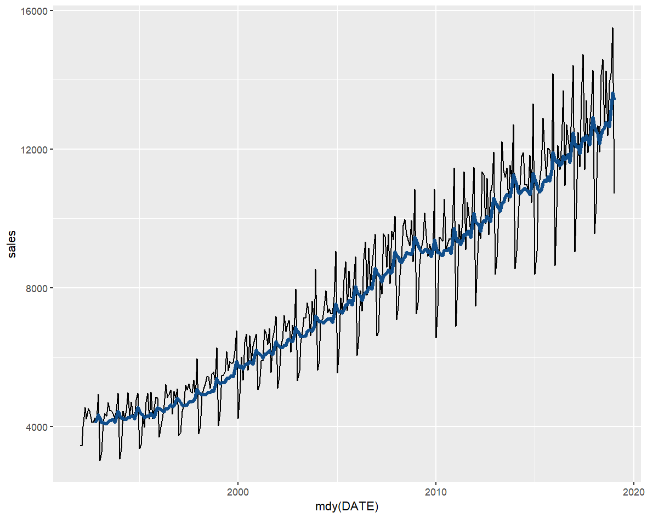
Suppressing seasonality

Slide 28
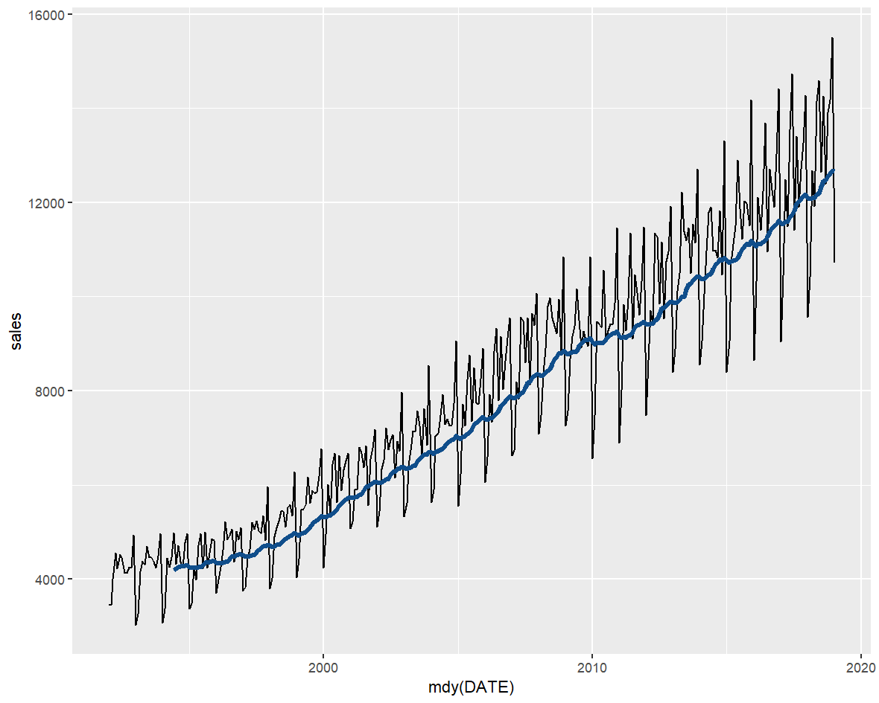
Suppressing seasonality

